Slide 1
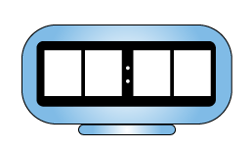
Calculate time intervals using the 24-hour clock.
This is a 24-hour digital clock. What would this time look like on a 12-hour digital clock?
When is it useful to use a
24-hour digital clock rather than a 12-hour digital clock?
1
6
3
0
Hours
Minutes
A school science lesson starts at 10:45 and ends at 11:35.
How long does it last?
Sketch a time number line to represent this on your whiteboard.
How many minutes until 11 o’clock? Remember that we are counting up to 60, not 100…
35 mins
15 mins
10:45
11:00
11:35
15 mins + 35 mins = 50 mins

Slide 2
Calculate time intervals using the 24-hour clock.
A singing lesson starts at 13:50 and ends at 14:40.
How long does it last?
Sketch a time number line to represent this.
Let’s check…
40 mins
10 mins
13:50
14:00
14:40
10 mins + 40 mins = 50 mins

